Slide 1
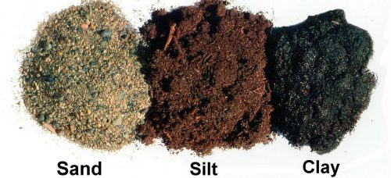
Types of Soil
Roya Falatoonzadeh

Slide 2
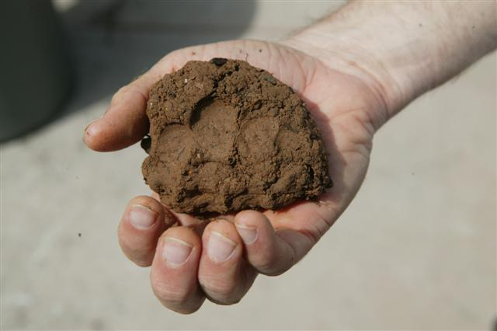
Clay Soil
Heavy
High in nutrients
Retains water
Winter: Wet and Cold
Summer: Dry

Slide 3
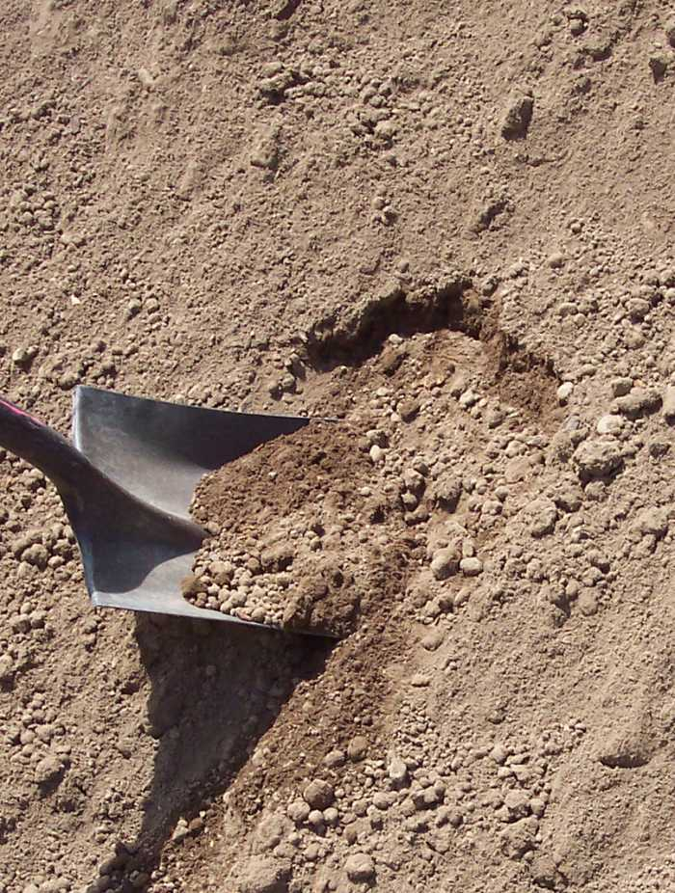
Sandy Soil
Dry out quickly (don´t retain water)
Light
Warm
Few nutrients

Slide 4
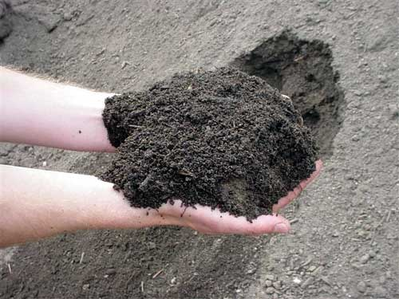
Silt Soil
Fertile
Light
Retains Moisture
Easily compacted

Slide 5
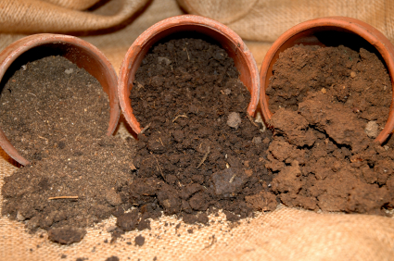
Loam Soil
Mixture of clay, sand and silt soils

Slide 6
Resources
https://www.rhs.org.uk/advice/profile?PID=179

