Slide 1
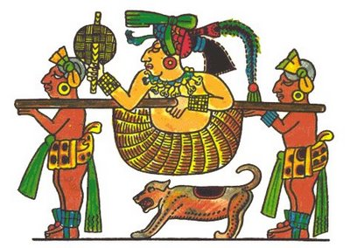
The Lordship Ethnics II
Antonio Martín

Slide 2
Main Lordships
The ethnic lordships which settled in present Ecuadorian territories had varying importance.
Some of them were large political units which integrated various chiefdoms. Others were quite small.

Slide 4
In the far north, the Quillacingas and Pastures lived.
Among the rivers Chota and Guayllabamba, there was a series of interconnected lordships: Caranqui, Cochasquí, Otavalo and Cayambe.
Quito had already set up a commercial and political center.
Towards the south were the lordships of Panzaleo, Píllaro, Sigchos and Puruhá.
The Yumbo Indians lived in the tropical southwest of Quito.
From the knot of Azuay to the south was located the lordship Cañari.
The paltas were in the far south.

Slide 5
On the northern coast, Atacames and Tolita were developed.
The most important lordship ethnic of the current Manabi was Manteño, and those that stood out in the current Guayas were Huancavilcas, Punáes and Chonos.
In the Amazon region, Cofan, feral and Quijos people lived.

Slide 6
Trade
There was an important and constant exchange of product between ethnic lordships. Part of their alliances was to keep the barter of products between different villages. To do this, specialized groups in trading were formed, who were called mindalaes.
In some cases, even confederations were formed for the purpose of trading, such as “the merchants manteños leagues."

Slide 7
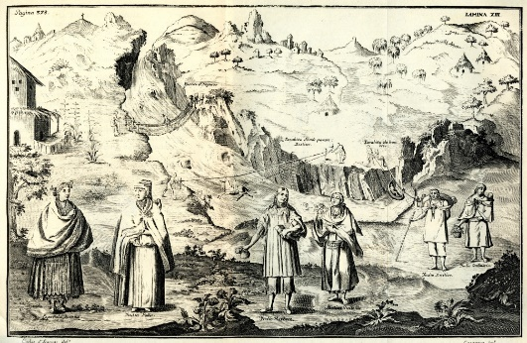
The Confederations
After the year 1000 A.D., some chiefdoms and ethnic lordships were grouped to form confederations of larger land areas.
The chiefdom authority over other chiefdoms was recognized by wars, alliances, and marriages.
Some of the large lordships that were in charge of alliances were Caranqui-Cochasquí, in the north, and the Canari, in the southern Sierra.

Slide 8
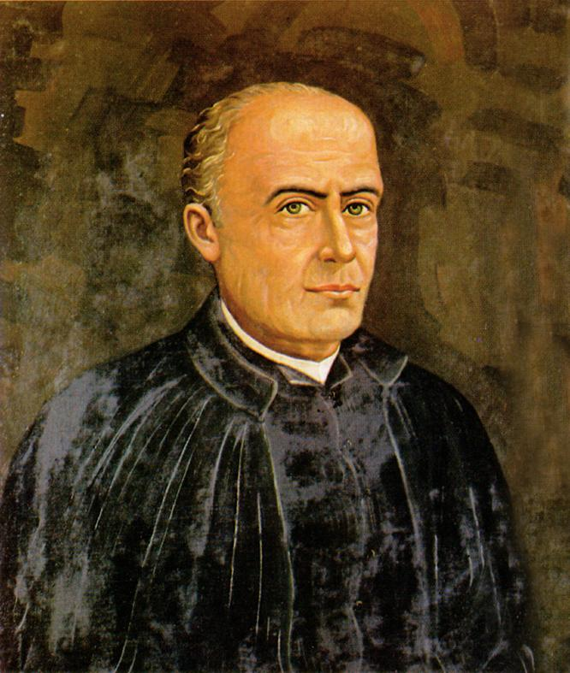
Traditional historians, following the history of Father Juan de Velasco, perceived this reality with a Western European vision and spoke about the existence of the Kingdom of Quito, which covered most of present-day Ecuador.
But that kingdom is just a beautiful legend.
However, the remarkable work of Velasco provides us with many clues about our ancient history, and that’s why Velasco (video) should be considered as one of our most important classics.

Slide 9
Source
Estudios Sociales, Corporación Editora Nacional. Ministerio de Educación de Ecuador. Imprenta Mariscal.

