Slide 1
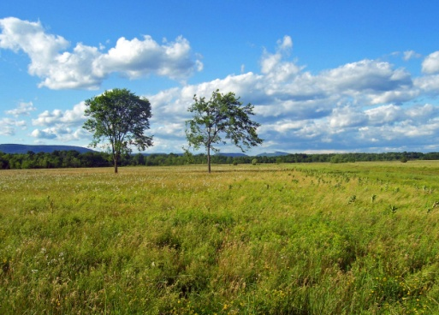
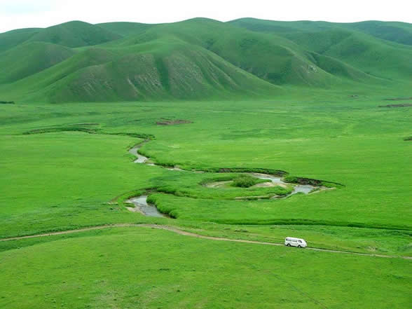
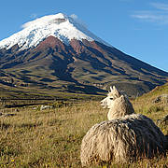
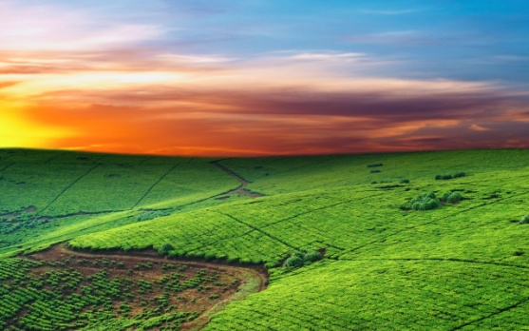
Unit of Inquiry: Sustainable Conservation of the Grasslands
Roya Falatoonzadeh

Slide 2
General Information
Transdisciplinary Theme:
Sharing the planet
Title:
Sustainable conservation of the Grasslands
Central Idea:
The biomes are home to many species and provide important resources for the whole planet

Slide 3
Concepts
Key Concepts:
Caustion: How do biotic and abiotic elements interact in a biome?
Responsability: Use and conservation of soil in aboriginal societies and actual societies.
Reflection: How do I understand what I am reading?
Related Concepts:

Slide 4
Lines of Inquiry
Line of Inquiry 1: Biotic and abiotic elements in grasslands.
Line of Inquiry 2: The relationship between the sustainable use and conservation of the environment and the development of aboriginal societies.
Line of Inquiry 3: Human influence on grasslands and ways of preservation

Slide 5
Teacher Questions
What are renewable and nonrenewable resources?
What types of plants and animals can we find in the grasslands in Ecuador?
How can we conserve the soil in the grasslands?
How can we conserve water?
Once agriculture was discovered, how did it influence in the development of the aboriginal societies?
How did the Incas conserve the natural resources and their environment to continue developing?
How can we conserve our grasslands to have a sustainable agricultural development?

Slide 6
Summative Assessment Activity
Line of Inquiry 1: Biotic and abiotic elements in grasslands.
Play: Grassland Soil and its influence on living things
Line of Inquiry 2: The relationship between the sustainable use and conservation of the environment and the development of aboriginal societies.
Write a 1-2 page essay
Line of Inquiry 3: Human influence on grasslands and ways of preservation
“Preservation of rasslands Biome” Album
Preserve Grasslands Campaign

