Slide 1
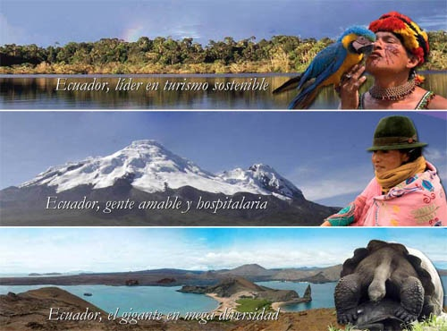
Biomes in Ecuador

Slide 2
Group Activity
What types of biomes are there in Ecuador?

Slide 3
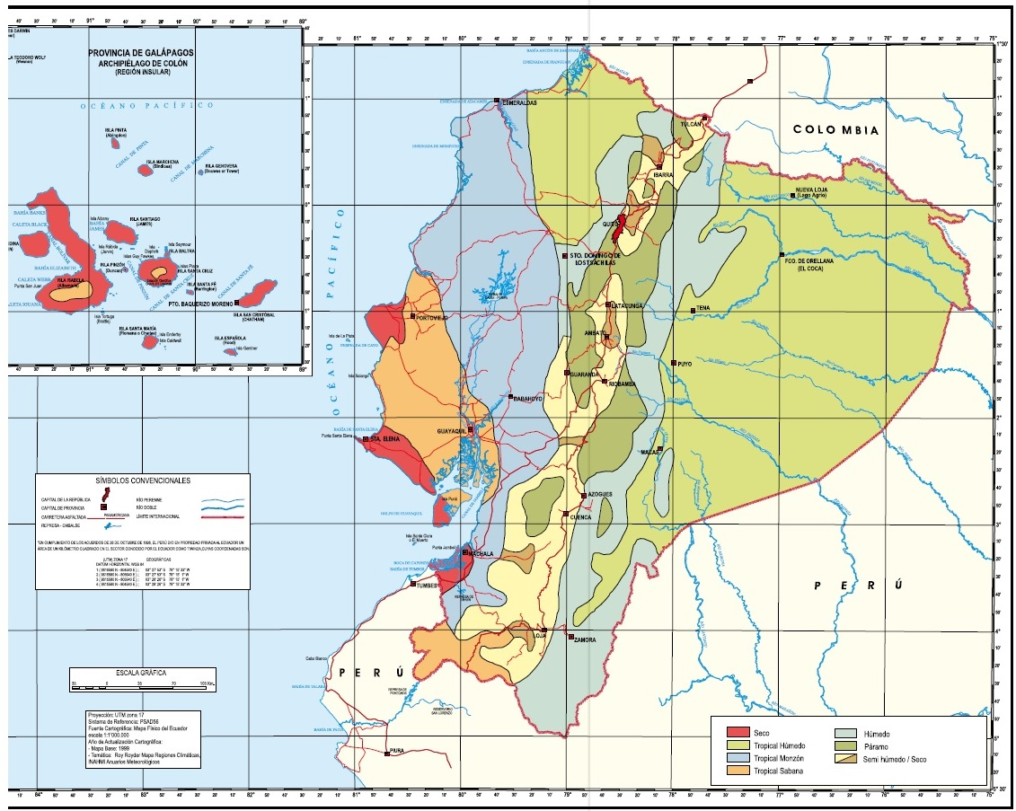

Slide 4
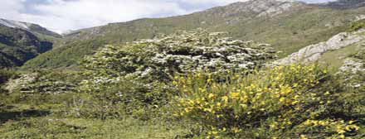
Grassland Biome in Ecuador
Grasslands are characterized by humus-rich soils and low vegetation. At times, shrubs such as Polylepis and “ramineas” can be found here.

Slide 5
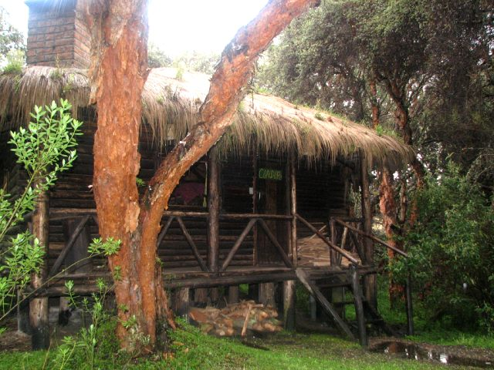
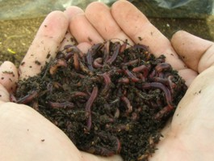
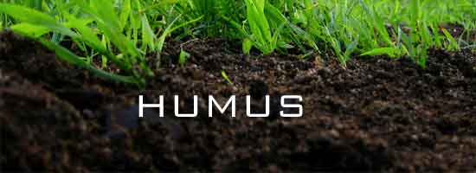
Humus: a topsoil, formed by the decomposition of plants and animals.
Polylepis Genre: Includes approximately 28 species of small trees and shrubs, and its common name is “quenua”.

Slide 6
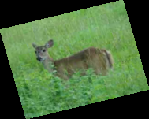
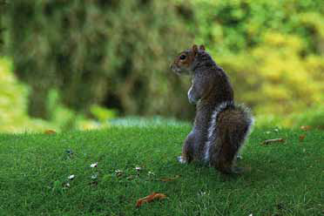
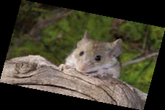
In the coast these biomes are known as savannas or grasslands. In the highland region they are called moorlands.
They are characterized by the existence of high humidity.
The animal species that live there are mainly herbivores such as deer, squirrels, voles, etc.

Slide 7
Physical characteristics of the grassland biome in Ecuador
Coastal Region | Highland Region | Amazon Region | Insular Region
They are fertile due to moisture in the soil. |  | Few nutrients in the soil. | Lands covered with lava and volcanic ash
Flat area and low altitude. | It is located at a height of 2,700 meters. | It is at the same altitude as the Ecuadorian tropical savanna found in the coast. | Introduced by human activity for agriculture.

Slide 8
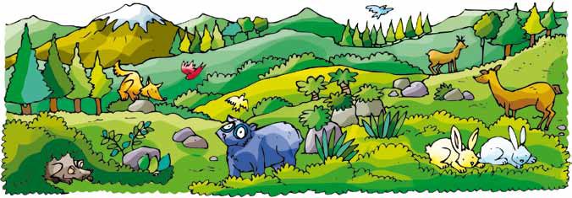
Forest Biome In Ecuador
Our country has many forests, the main ones are: “Montano” forest, cloud forest, dry forest and tropical rain forest. Each of them has its own characteristics: vegetation, location, climate and wildlife.

Slide 9
Forest | Location | Climate | Vegetation | Fauna
Montano | Valleys along the Andes. | Mild | Laurel, eucalyptus, cedar, rosemary, “chilcas”, “achupallas”, “pumamaquis”, etc.. | Hummingbirds, robins, goats, deer, mice, condors, etc.
Cloud | Foothills of the Andes, Mindo and Papallacta. | Covered by clouds, but higher humidity | Myrtles and guayabillos. | “Rooster of the rock”, hummingbirds, spectacled bears, etc.
Dry | Forests and valleys of Guayllabamba and Tumbaco in the province of Pichincha. Also located in Guayas and Manabi. | High temperatures and low rainfall | Dwarf trees and thorny plants such as alder and “pumamaquis”, in the Sierra. In the Coast: “ceibos” and “guayacanes” | Pumas, howler monkeys and “guantas”.
Tropical Rain | Amazon | Very humid throughout the year. | Cedar, epiphytes, bromeliads, cat's claw, etc.. | Manatee, armadillos, agoutis, snakes, monkeys.

Slide 10
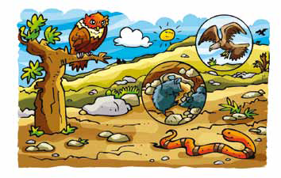
Desert Biome
This biome is characterized by being extremely dry. It hardly rains and, therefore, there is low humidity.
There is sparse vegetation and large areas of bare ground. In these biomes grow some plant species such as dry brush, nags, cacti, prickly pears and other thorny plants.
Among the fauna there are reptiles (snakes) and mammals (foxes and possums), insects, birds and night rodents.

Slide 11
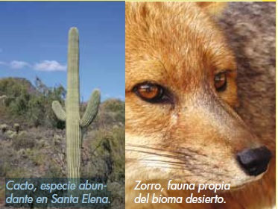
The desert biome in Ecuador is located on the peninsula of Santa Elena, which corresponds to the coastal region.
In picture at the bottom you can see an animal and a plant specie that live in this biome.

Slide 12
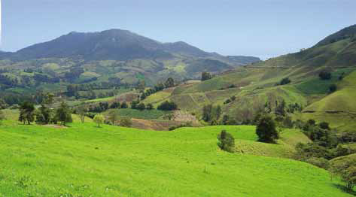
Natural Grasslands
Natural grasslands are formed without human intervention. They are characterized by fertile lands that are rich in humus. The areas covered by this type of vegetation can of high or low altitude.
Overall, this biome has a continuous layer of grass and almost no trees, except along the rivers. In the past, they occupied large tracts of land and were being located in the central area of continents.

Slide 13
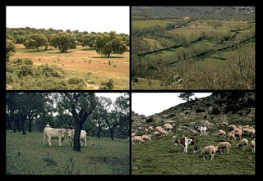
Anthropic Grassland
Anthropic grasslands are formed by human intervention. Water and fire are crucial factors in the existence of this biome.
Many times people start grassland fires with the goal of improving the quality of the soil.
Overgrazing is an activity that can harm or convert grasslands to deserts.

Slide 14
Natural and Anthropic Grasslands of the Highland Region
This biome is also known as tropical savanna and elsewhere the continent is called prairie.
These zones are ideal for agriculture if there is an existing irrigation system. In places where rainfall is low, only grasslands can be found, which are used for intensive grazing of cattle and goats.

Slide 15

Natural and Anthropic Grasslands in the Highland Region
In the highland region of Ecuador, there are plenty of low grasslands due to the high humidity.
Grasslands located in the Ecuadorian highlands are also called moors.

Slide 16
Natural and Anthropic Grasslands in the Highland Region
These lands are suitable for farming.
They have rich soil and organic matter.
They are found in the valleys as Paute, Chota and Guayllabamba.
These biomes suffer from some anthropic events such as deforestation, soil erosion and overexploitation.
The dominant vegetation of the Andean highlands is the grassland, which is formed by various types of grasses.

Slide 17

Coastal Grassland Region
Fertile lands in the river basins.
They are located in the provinces of Los Ríos, Guayas, El Oro, and some parts of Manabi and Esmeraldas.
They have organic matter pools.
Rice is mainly cultivated.
Other crops include: cassava, papaya, citrus, oil palm, pasture for livestock, etc..

Slide 18

Natural and Anthropic Grasslands in the Amazon Region
The climate of this region consists of abundant rainfall and vegetation influences. Abundant natural forests and large areas of grasslands are used for livestock.
Farming practices generally face various problems such as logging, road construction, etc.. Some areas are restricted in this region of Ecuador because they have been declared protected areas.

Slide 19
Why are few nutrients on the Amazon soil?
There are few nutrients in the soil of the Amazon region because the heavy rain produces weathering and erosion of the soil, washing away the nutrients.

