Slide 1
Objects and complements
What is an object?
What is a complement?

Slide 2
How do we find an object?

Slide 3
Find the verb
Action verb: run, jump, walk, talk
Find the subject
Subject + verb
What?
object

Slide 4
Pau and Anto played basketball during recess.
Find the verb
Action verb:_________
Find the subject
________________+ _______
What?
_________

Slide 5
Giuli and Sebas ate pizza for dinner.
Find the verb
Action verb:_________
Find the subject
________________+ _______
Who? What?
_________

Slide 6
Charlie bought a lego game at the mall.
Find the verb
Action verb:_________
Find the subject
________________+ _______
What?
_________

Slide 7
How do we find complements?

Slide 8
Linking verb
=
Subject = complement

Slide 9
Isaac is the goalkeeper.
=
=

Slide 10
Teacher Pau was a chocolatevour.
____
=
_____ = _________

Slide 11
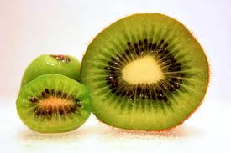
OBJECT
Follows and action verb and answers “Who? or what?" . It`s always a noun or pronoun.
Action verbs: run walk jump like
Daniel likes kiwi.
likes what?

Slide 12
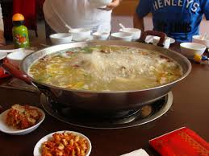
COMPLEMENT
Follow a linking verb and describe the subject
Linking verbs:
is are am was were
smell taste feel look
The soup is delicious.
=

