Slide 1
practice Possessives
This is Karlita`s dog.
This dog is hers.
This is her dog.
This is Sebas’ ball.
This ball is his.
This is his ball.

Slide 2
These chairs belong to us.
These pens belong to Dani and Isa.

Slide 3
The book belongs to me.
The cat belongs to you.

Slide 4
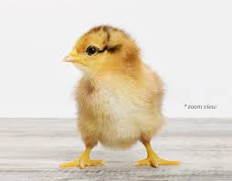
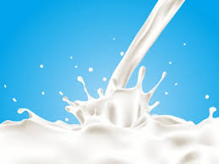
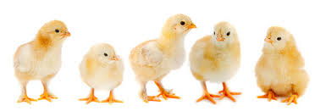
COUNTABLE AND UNCOUNTABLE NOUNS
COUNT NOUNS
NON-COUNT NOUNS
CAN BE COUNTED
SINGULAR AND PLURAL FORMS
CAN`T BE COUNTED
ALWAYS IN SIGULAR FORM
A CHICK
__CHICKS
MILK

Slide 5
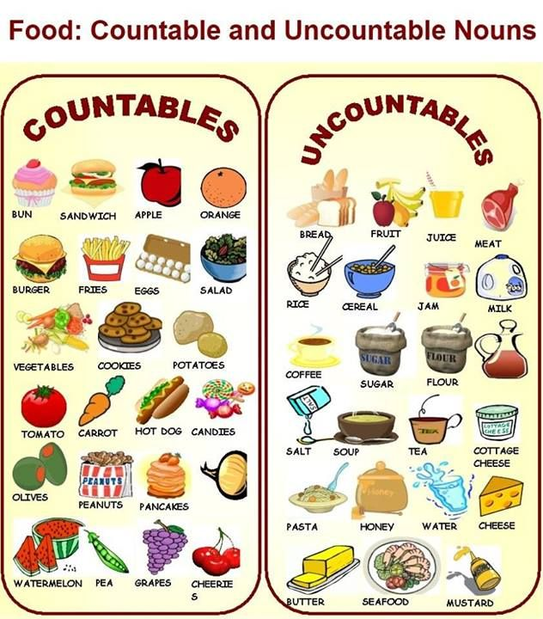

Slide 6
NB Foldable: count and non-count nouns use magazines to find real pictures

